Slide 1
Shifts in video and LMS adoption: Impact on student outcomes
Wednesday, April 26 at 2 p.m. Eastern
Notes:
PHIL

Slide 2
Moderator:
Presenters:
Phil Hill
Co-publisher, e-Literate
Partner, MindWires Consulting
phil@mindwires.com
Fred Singer
Founder and CEO, Echo360
fsinger@echo360.com
Michael Feldstein
Co-publisher, e-Literate
Partner, MindWires Consulting
michael@mindwires.com
2
Notes:
PHIL

Slide 3
Setting the Stage
Why have LMS and video platforms not fulfilled the pedagogical promise in the classroom?
How do we shift from technology-as-a-utility to technology that drives positive outcomes?
What can we learn from other industry best practices to guide us?
3
Notes:
PHIL

Slide 4
Why is 90%+ of technology spend not focused on learning outcomes?
Many purchased technology systems have the words “learning” in them but actual workflows are ”administrative” in nature.
Pedagogical deployments tend to be experimental – not scaled
Technology spend treated as a cost center – not an investment to improve economics and efficacy of learning.
4
Notes:
FRED

Slide 5
3 Drivers for Outcomes
+
+
Blended/Active Learning
Engagement
Big Data
Video Learning
Big data needs little data.
“Behavioral Data”
Instructor + Mobile Classroom
Social Learning
Notes:
FRED

Slide 6
Era of More LMS Competition
6
Notes:
MICHAEL

Slide 7
Adoption Cycles Shortening
7
Notes:
MICHAEL

Slide 8
LMS as Portal for Learning Applications
8
Notes:
MICHAEL

Slide 9
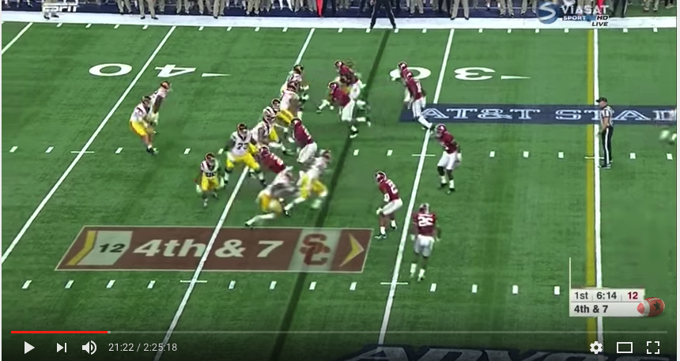
Case example: managing video for convenience or …
Video Library
Notes:
FRED

Slide 10
… or integration into teaching and learning?
Notes:
FRED

Slide 11
How can you make the most effective decisions?
Notes:
MICHAEL

Slide 12
1. Form a selection committee with key stakeholders.
Every stakeholder should have a voice - including students.
Getting meaningful feedback is hard. Think it through in advance.
Process must be transparent and fair.
Assurance concerns have been heard and considered.
12
Notes:
MICHAEL

Slide 13
Think of the selection process as social infrastructure.
A decision-making process that successfully includes all stakeholders for one procurement can work for other kinds of decisions.
Procurement conversations are rare opportunities to talk about pedagogy and outcomes across the campus community. Take advantage.
Think about larger drivers for the technology selection from the beginning. Keep the process and the language focused on those drivers and goals.
If you do these things, you will have something more valuable than a good piece of software. You will have the foundations of a community.
For an example of how to communicate the opportunity with stakeholders, see these explainer videos prepared for the California Community Colleges Online Education Initiative (CCC OEI).
13
Notes:
MICHAEL

Slide 14
2. Develop a flexible but scaled academic strategy.
+
+
Blended/Active Learning
Engagement
Big Data
How do you leverage devices to extend and personalize learning?
How do you support interaction both inside and outside of the classroom?
Can students actually interact with content, not just passively consume it?
Can students engage regardless of the level of teacher adoption?
Does the vendor provide evidence of student learning gains?
Is the system open? Can data flow freely to/from your other systems?
Notes:
FRED

Slide 15
3. Spend more time analyzing architecture vs. features.
Cloud. Ensure technology is “of the cloud”, not “in the cloud”
Scalability. Request proof of scale, both technically and financially
Open Architecture. Prioritize open, standards-based integration to easily integrate multiple systems
Partnership. Look for commitment to customer service and true partnerships.
Notes:
FRED

Slide 16
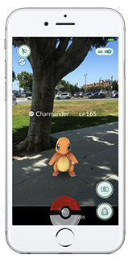
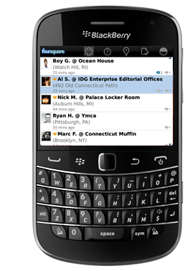
4. Future proof technology architecture by grounding choices in actual student and instructor behaviors.
Mobile Device A Decade Ago
Email Use
Mobile Device Today
Full Computer
Notes:
FRED

Slide 17
4. Future proof technology architecture by grounding choices in actual student and instructor behaviors.
News Consumption Decade Ago
News Consumption Today
Notes:
FRED

Slide 18
4. Future proof technology architecture by grounding choices in actual student and instructor behaviors.
Traditional Lecture Hall
Today’s Modern Classroom
Notes:
FRED

Slide 19
4 Key Takeaways
Form a selection committee with critical stakeholders.
Develop a flexible but scaled academic strategy.
Spend more time analyzing architecture vs. features.
Future proof technology architecture by grounding choices in actual student and instructor behaviors.
Notes:
PHIL

Slide 20
Questions?
Notes:
PHIL

Slide 21
Join the Conversation
https://echo360.com/blog/
http://mfeldstein.com/
http://e-literate.tv/
@FredSinger
@echo360
@PhilOnEdTech
‪@eLiterateTV‬
@mfeldstein67
Notes:
PHIL

